Slide 1

Simplicity vs. Performance

Slide 2
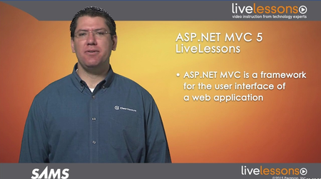




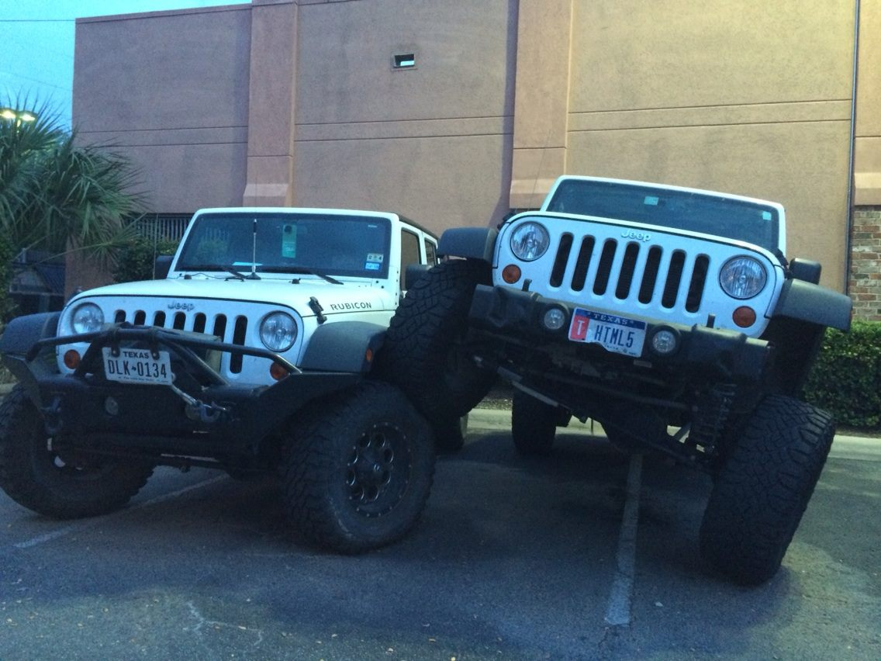
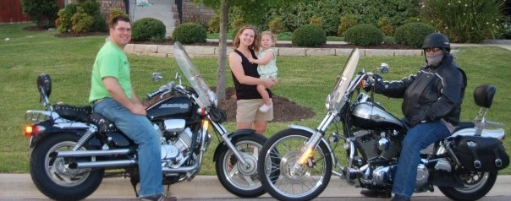
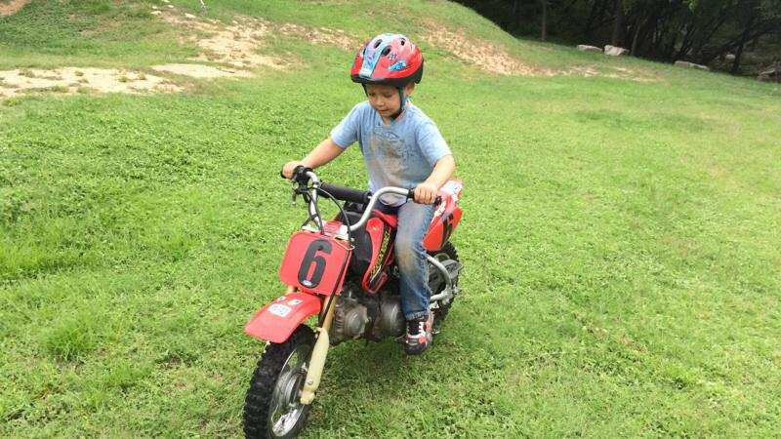

Jeffrey Palermo
http://jeffreypalermo.com/about/

Slide 3
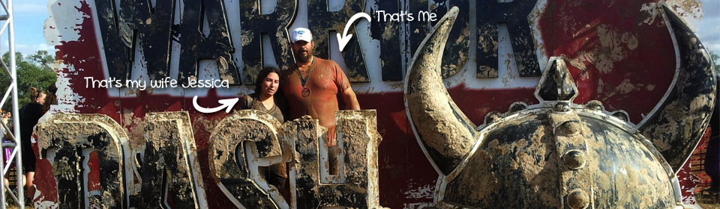

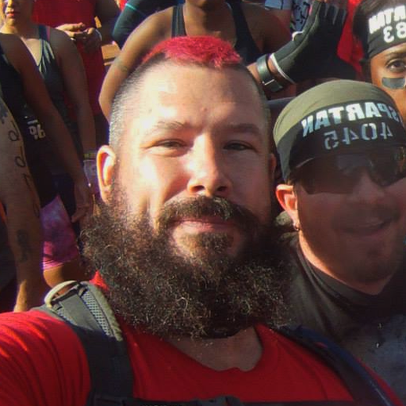

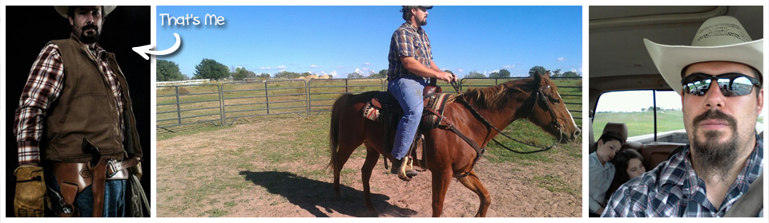


Andrew Siemer
http://about.me/andrewsiemer

Slide 4
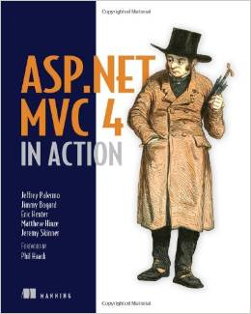

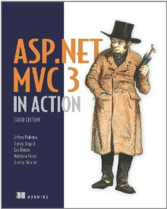
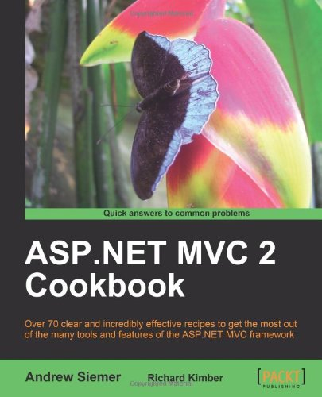

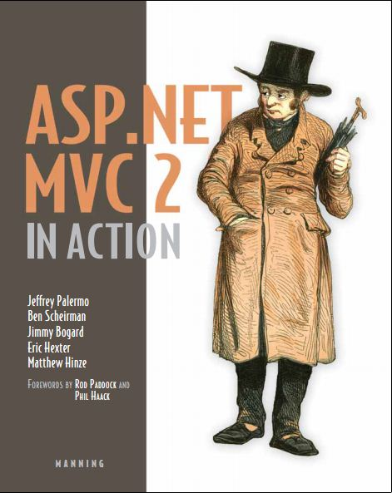



Slide 5

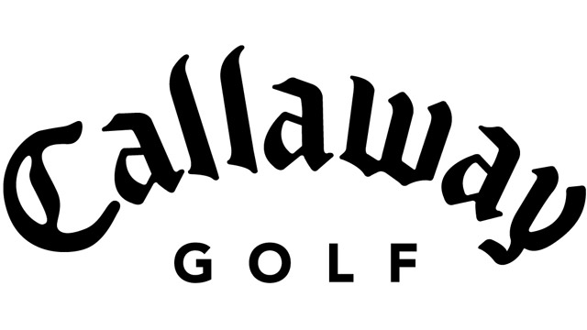









← We are hiring!!!

Slide 6
Simplicity VS. Performance

Slide 7
We’ve screwed up!
We’ve worked through all kinds of barriers to performance.
We’ve employed NServiceBus on Dell.com, big retailers, financial institutions, etc.

Slide 8
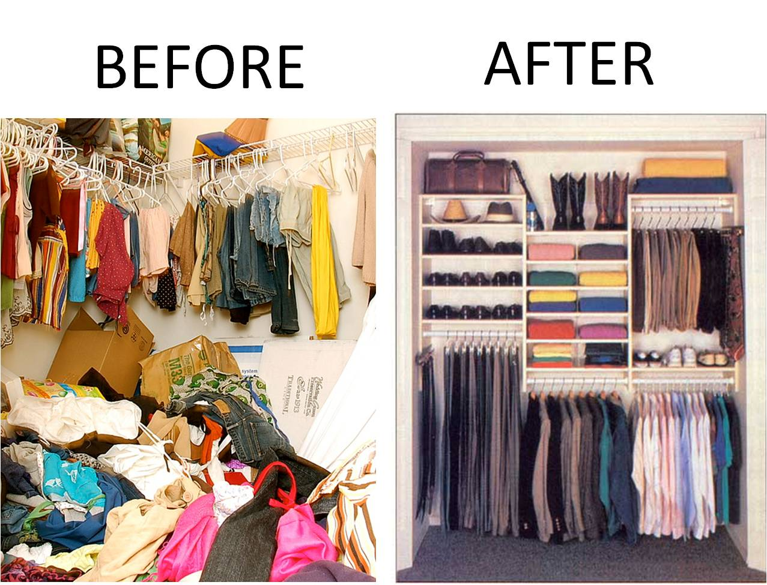
Simplicity yields performance

Slide 9
Executive summary
Don’t distribute
Martin Fowler’s First Law of Distributed Object Design: Don’t distribute your objects!
The network is reliable.
Latency is zero.
Bandwidth is infinite.
The network is secure.
Topology doesn't change.
There is one administrator.
Transport cost is zero.
The network is homogeneous.
Minimize processing in the saga
Don’t share queues/processes across SLAs – decouple fault/surge isolation
Don’t use a saga when a normal handler will suffice

Slide 10
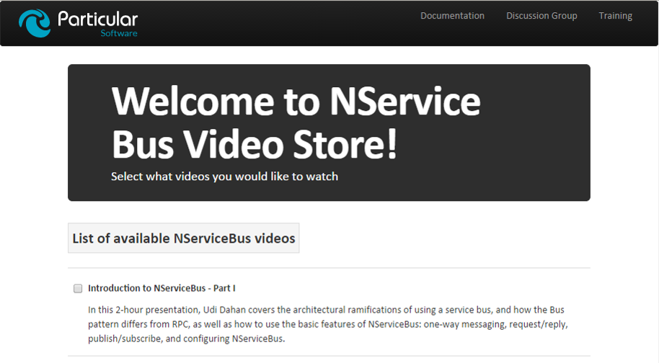
Example application

Slide 11
Problem: god Sagas
All actions managed by the saga
All work done in the context of the saga
Very slow
Hard to manage
Let’s look at the code. . . RUN IT!!

Slide 12
god Sagas – test scenario
Roughly 1000 orders created
16 minutes 26 seconds to complete

Slide 13
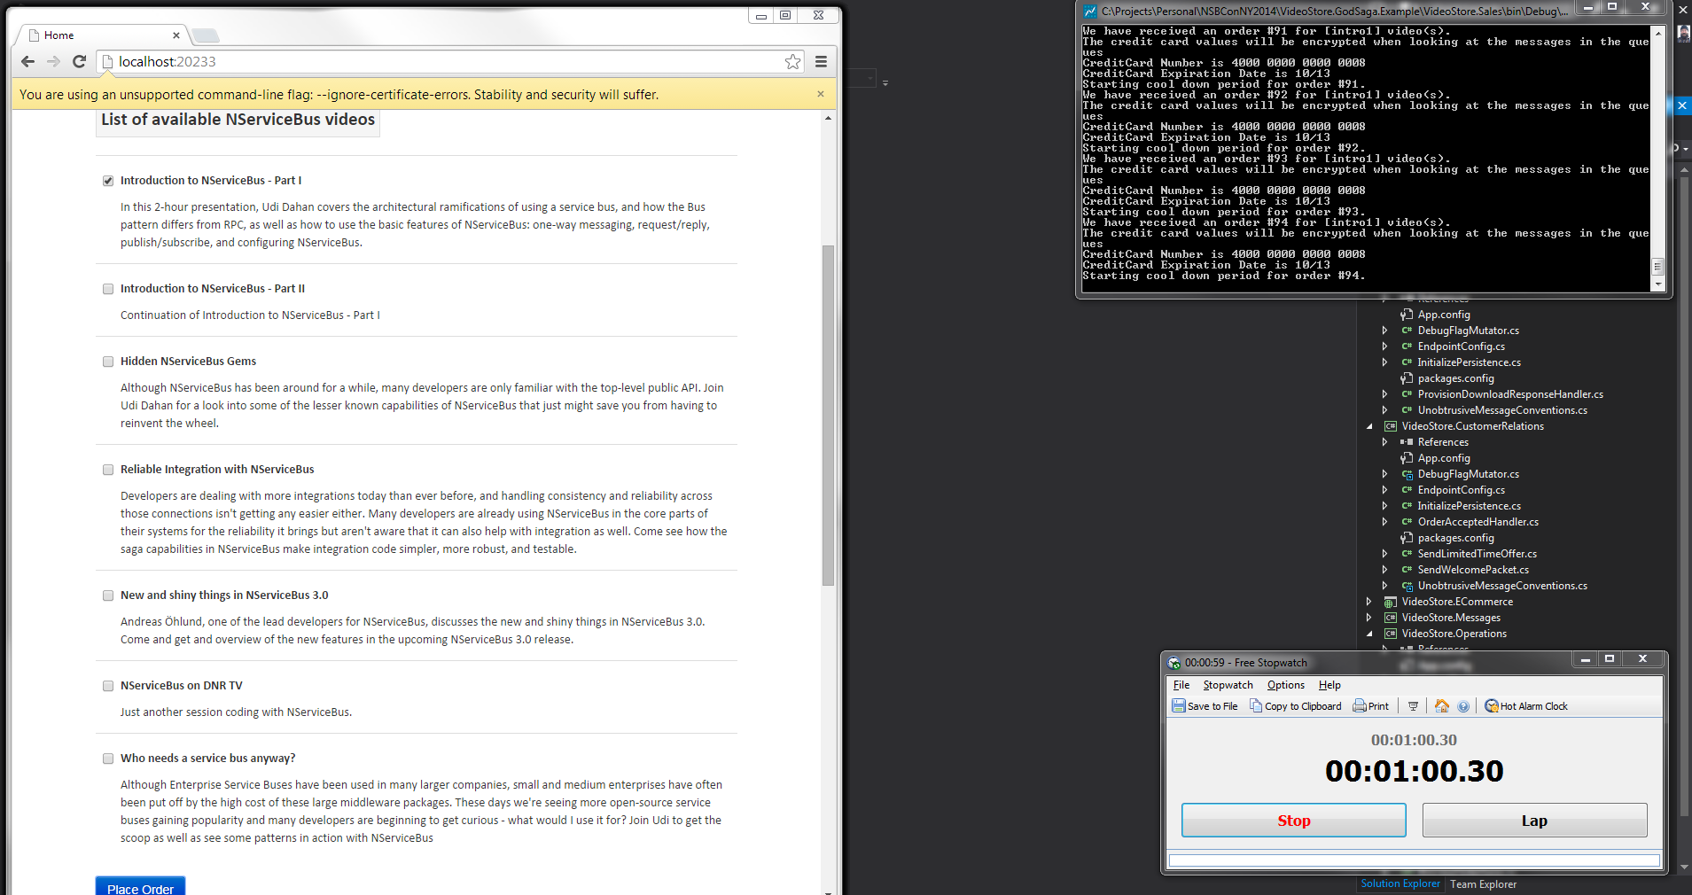

Slide 14
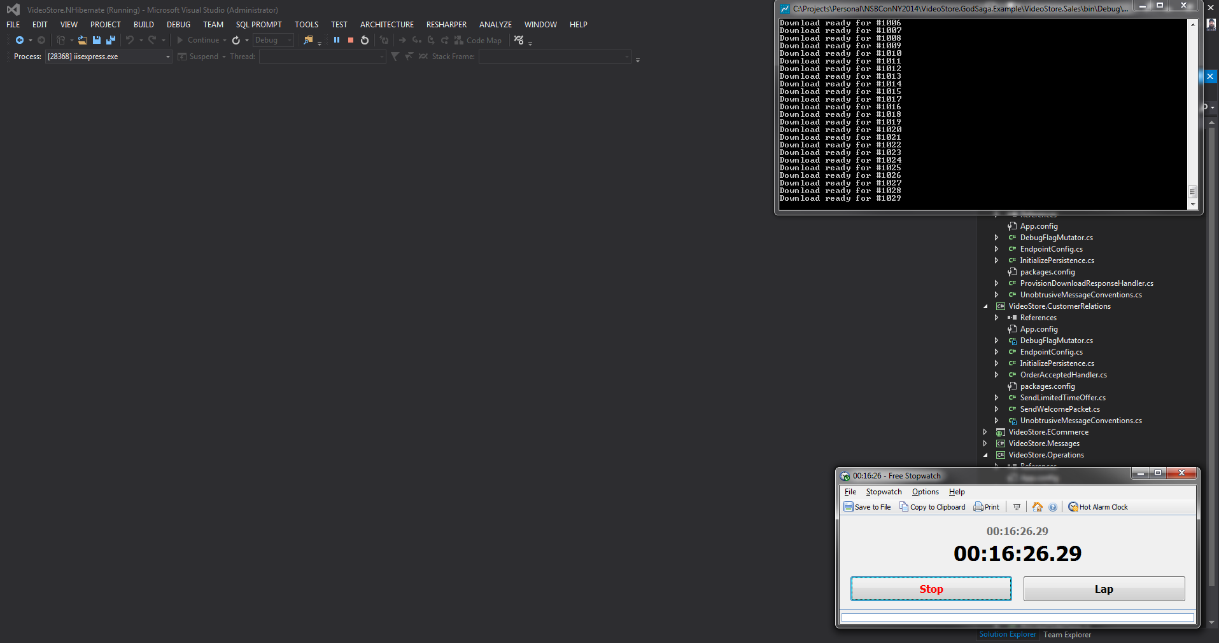

Slide 15
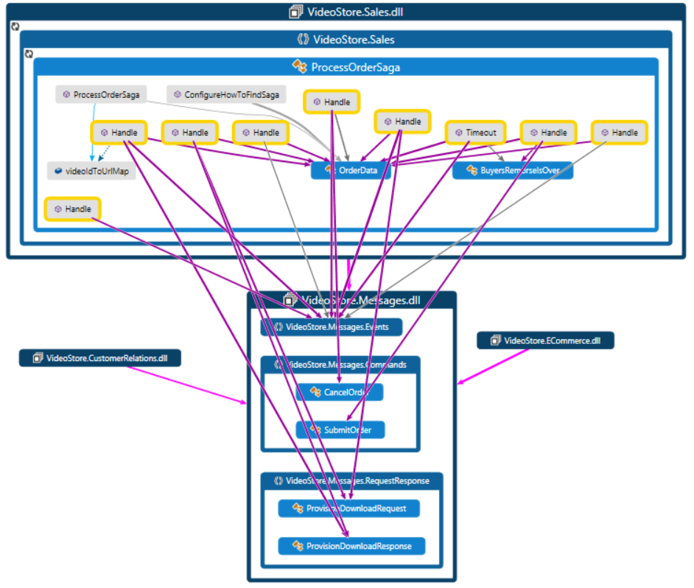
god Saga depends on everything

Slide 16
Solution
Use sagas only for orchestration – not integration or processing logic

Slide 17
Refactor to: Thinner saga, single process
Saga only manages taking and cancelling orders
All handler methods refactored into classes
More SOLID code (child’s play)

Slide 18
Remaining problem: single process
Roughly 1000 orders created
9 minutes 57 seconds to complete
Processed eventually!
Let’s take a look at the code. . .

Slide 19
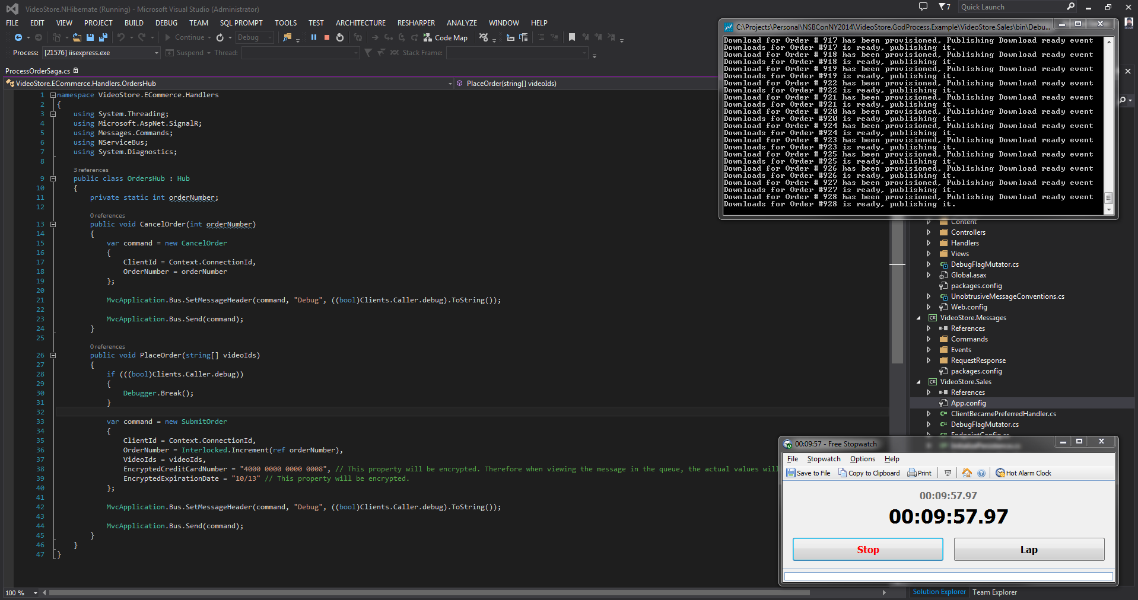

Slide 20
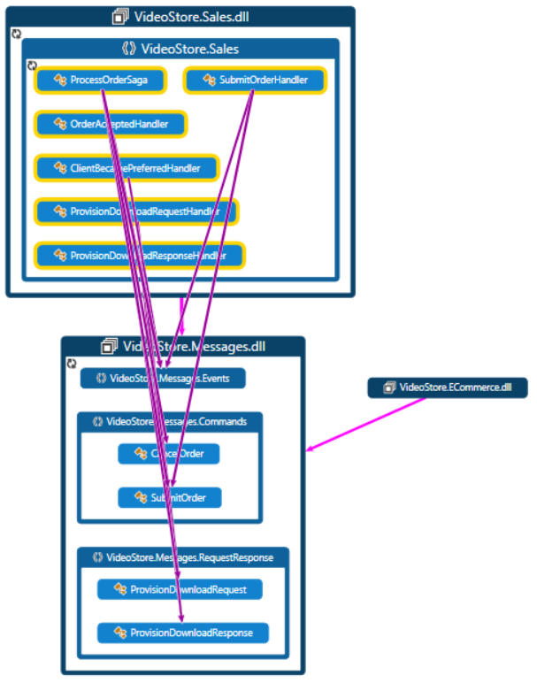
Single process, separate handlers structure

Slide 21
Solution
Separate handlers into dedicated worker processes

Slide 22
Refactoring: multiple processes
Saga only manages taking and cancelling orders
All handler classes refactored into their own processes
Can scale handlers/processes independently

Slide 23
Refactored performance
Roughly 1000 orders created
7 minutes 53 seconds to complete
Processed twice as fast!
Could be faster hosted across multiple machines
Messages of varying throughput levels can maintain SLAs

Slide 24
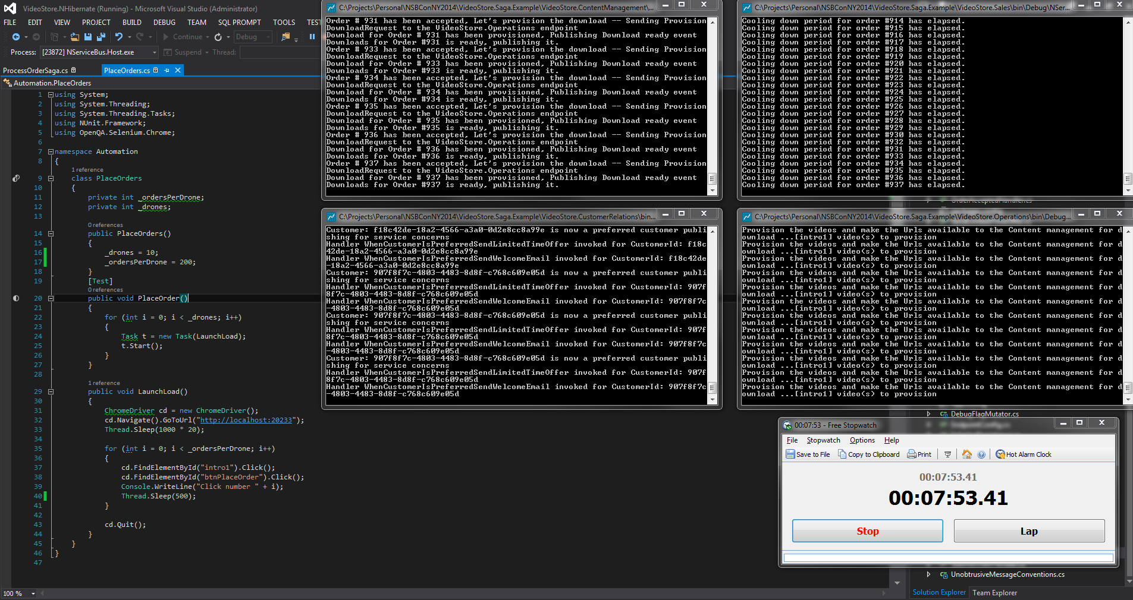

Slide 25
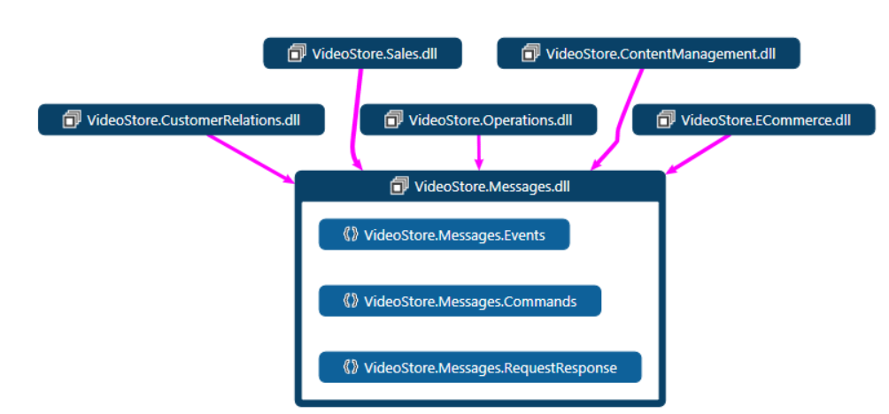
A place for everything & everything in its place

Slide 26
Don’t overuse the saga. . .
Unless you have an orchestration/workflow
And get out of a saga method as fast as possible
For maintaining any data other than orchestration (SagaData)
Unless you have to

Slide 27

Come work with us in Austin!
Jeffrey Palermo
jeffrey@clear-measure.com
@jeffreypalermo
Andrew Siemer
andrew@clear-measure.com
@asiemer
#LoveClearMeasure

